Slide 1
Virtual Velocity Banking Application
Authors:
fahad hameed & Dharmesh moradiya

Slide 2
Problem: where did all my money go?
Short Answer: You spent it.
Long Answer: Wasteful spending can be reduced by having a budget…but most people don’t have time to meticulously plan out their budgets.
Solution: This application doesn’t take all the thinking out of the equation, but it does provide a visual representation of exactly where your money is going.

Slide 3
VVBank
Theme: A Banking Application that allows you to track your expenses, and get a good idea of how much money you have spent in the last few months.
Side Thought: We could redo this application to be more of a ‘Expense Tracker’ instead of going with a bank theme. Might be more relevant to the user in the end…

Slide 4
How does it work?
You enter in your transaction data. Anytime you make a transaction that removes money from your account, it will be categorized in a common group.
You can view your transaction data in a tabular format, or in a pie chart.
You can filter by date, and see expenses for the last month, three months, or the last six months.
The more data you enter, the more accurate it becomes.

Slide 5
The Plan
4 Project Phases
Planning – 7 Days (Nov 11 ~ Nov 18)
Sketches, Scope, Brainstorming, Feature Definition
Design – 12 Days (Nov 18 ~ Nov 25)
Implementation, Iteration, Functionality, Exception Validation
Polish – 9 Days (Nov 25 ~ Dec 4)
Review, CSS, W3C Validation, Cleanup, Prepare Presentation
Presentation – 2 Days (Dec 4 ~ Dec 6)
Presentation Dry Run / Presentation Day

Slide 6
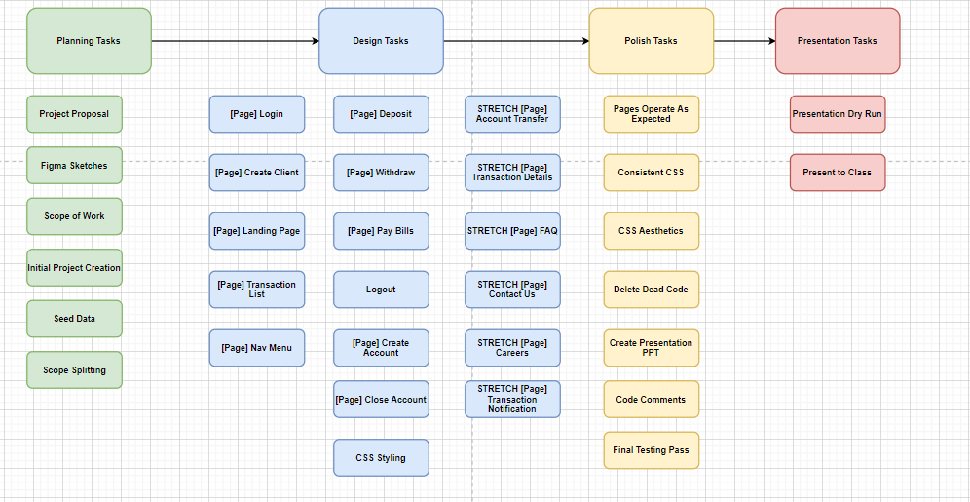
The tasks

Slide 7
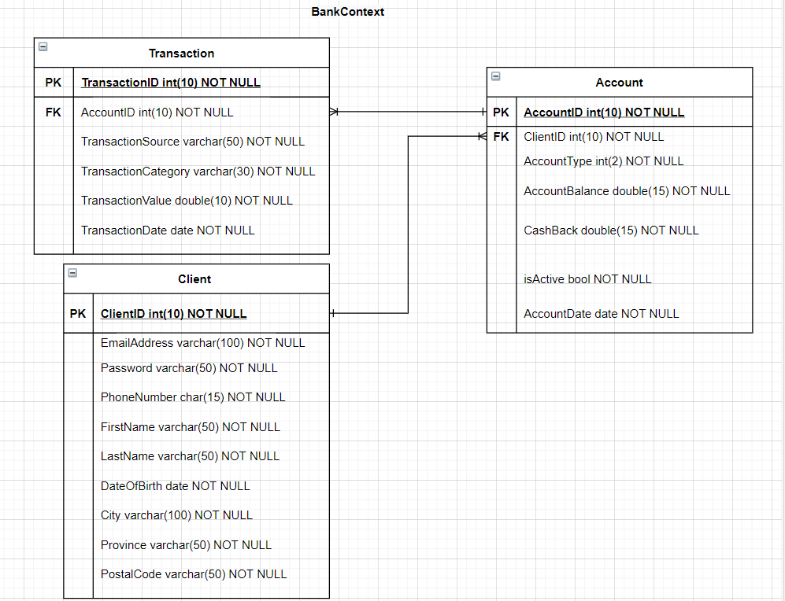
The database

Slide 8
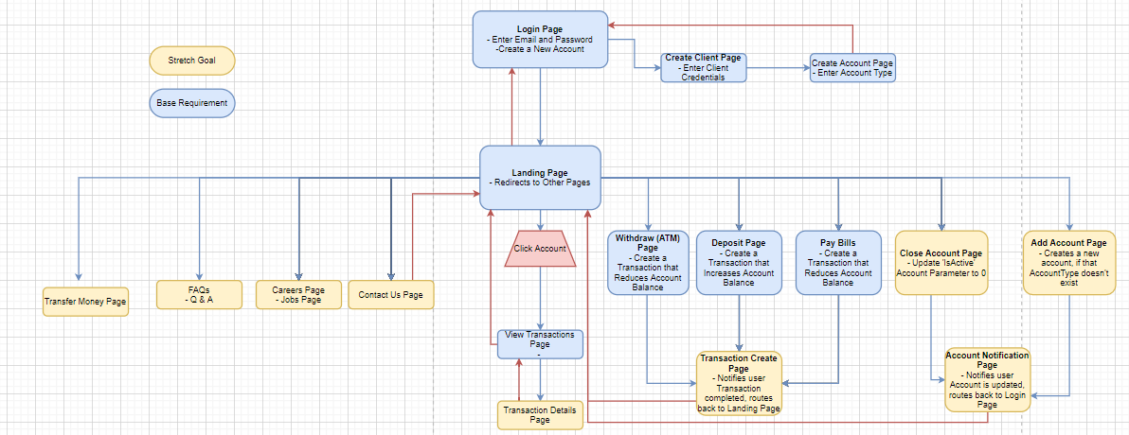
The site

Slide 9
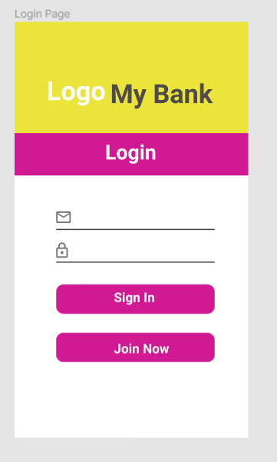
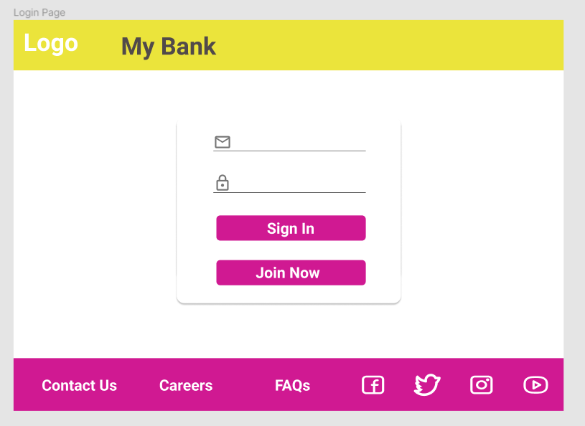
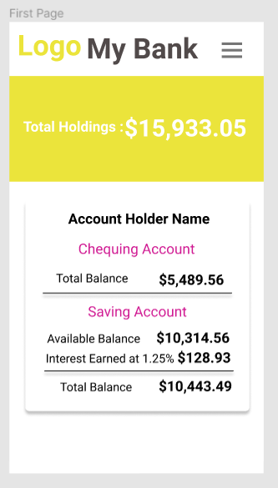
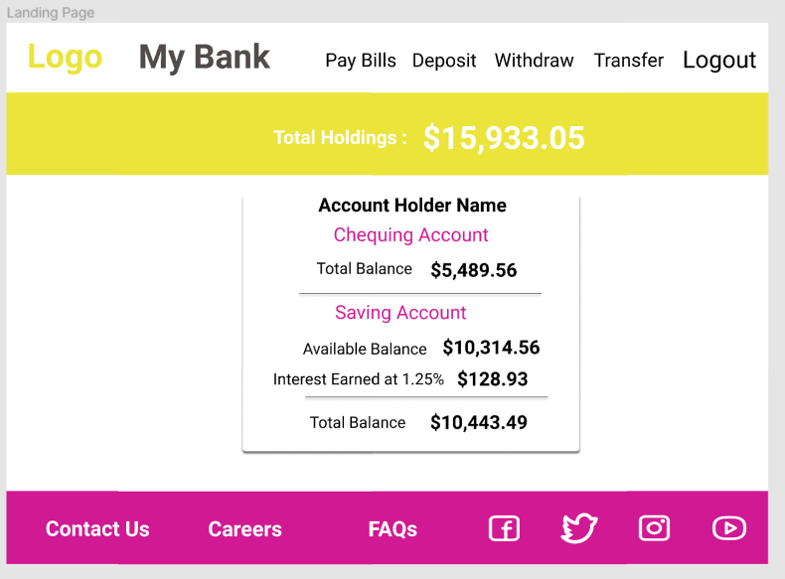
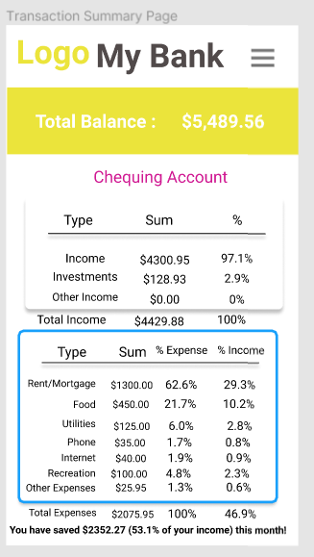
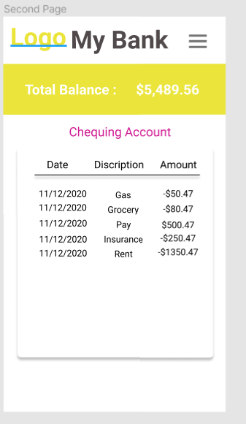
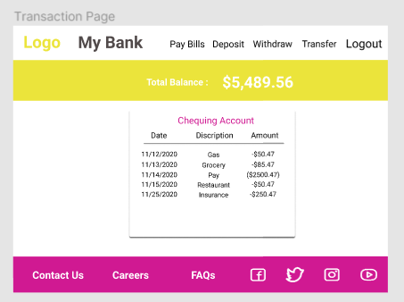
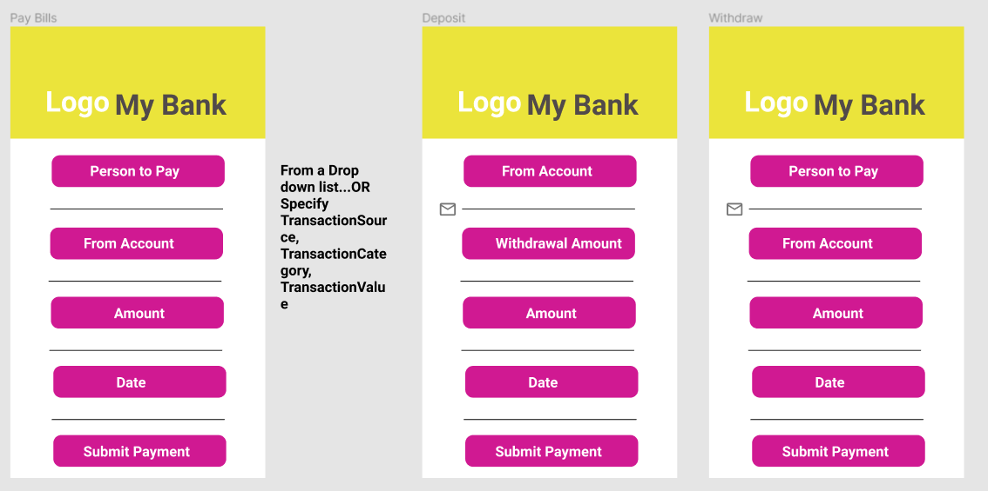
The design https://www.figma.com/file/6il3fCmu5tSvtvRl3hgCAY/Banking-Application?node-id=0%3A1

Slide 10
The application
Let’s see the application in action!

Slide 11
Any Questions?

